Slide 1

Workforce Safety and Wellness
CHAPTER 2

Slide 2
National EMS Education Standard Competencies (1 of 5)
Medicine
Applies fundamental knowledge to provide basic emergency care and transportation based on assessment findings for an acutely ill patient.
Notes:
National EMS Education Standard Competencies
Medicine
Applies fundamental knowledge to provide basic emergency care and transportation based on assessment findings for an acutely ill patient.

Slide 3
National EMS Education Standard Competencies (2 of 5)
Infectious Diseases
Awareness of
How to decontaminate equipment after treating a patient
Assessment and management of
How to decontaminate the ambulance and equipment after treating a patient
Notes:
National EMS Education Standard Competencies
Infectious Diseases
• Awareness of how to decontaminate equipment after treating a patient
• Assessment and management of how to decontaminate the ambulance and equipment after treating a patient

Slide 4
National EMS Education Standard Competencies (3 of 5)
Preparatory
Applies fundamental knowledge of the emergency medical services (EMS) system, safety/well-being of the emergency medical technician (EMT), medical/legal, and ethical issues to the provision of emergency care.
Notes:
National EMS Education Standard Competencies
Preparatory
Applies fundamental knowledge of the emergency medical services (EMS) system, safety/well-being of the emergency medical technician (EMT), medical/legal, and ethical issues to the provision of emergency care.

Slide 5
National EMS Education Standard Competencies (4 of 5)
Workforce Safety and Wellness
Standard safety precautions
Personal protective equipment
Stress management
Dealing with death and dying
Prevention of response-related injuries
Notes:
National EMS Education Standard Competencies
Workforce Safety and Wellness
• Standard safety precautions
• Personal protective equipment
• Stress management
• Dealing with death and dying
• Prevention of response-related injuries

Slide 6
National EMS Education Standard Competencies (5 of 5)
Workforce Safety and Wellness (cont'd)
Prevention of work-related injuries
Lifting and moving patients
Disease transmission
Principles of wellness and resilience
Notes:
National EMS Education Standard Competencies
• Prevention of work-related injuries
• Lifting and moving patients
• Disease transmission
• Principles of wellness and resilience

Slide 7
Introduction
To take care of others, we must take care of ourselves.
Recognition of hazards:
  Personal neglect
  Environmental and human-made threats
  Mental and physical stress
Notes:
Lecture Outline
I. Introduction
A. To take care of others, we must take care of ourselves.
B. Recognition of hazards to your health, safety, and well-being is important:
1. Personal neglect
2. Environmental and human-made threats
3. Mental and physical stress
C. The emotional well-being of the EMT and the patient are intertwined, especially in high-stress rescues.

Slide 8
General Health, Wellness, and Resilience (1 of 4)
General Health, Wellness, and Resilience (1 of 4)
Health is a complex interaction between physical, mental, and emotional connections.
Chronic physical, mental, or emotional stresses can worsen or increase the chance for developing health conditions.
Notes:
Lecture Outline
II. General Health, Wellness, and Resilience
Health is a complex interaction between physical, mental, and emotional connections.
1. Chronic physical, mental, or emotional stresses can worsen or increase the chance for developing health conditions.

Slide 9
General Health, Wellness, and Resilience (2 of 4)
Not all reactions to stress are negative.
  Eustress (good stress) creates a positive response.
  Distress causes a negative stress response.
Notes:
Lecture Outline
B. Wellness and stress management
1. Not all reactions to stress are negative.
a. Eustress creates a positive response.
i. Increased focus, increased energy in the short term, and increased job satisfaction and self-image in the long-term
b. Distress causes a negative stress response.

Slide 10
General Health, Wellness, and Resilience (3 of 4)
Wellness is the active pursuit of a state of good health.
Resilience is the capacity of an individual to cope with and recover from distress.
  Eat a healthy and well-balanced diet.
  Ensure a minimum of 7 to 9 hours of sleep.
  Strengthen positive relationships with family and friends.
Notes:
Lecture Outline
2. Wellness is the active pursuit of a state of good health.
3. Resilience is the capacity of an individual to cope with and recover from distress.
a. The following practices can help increase resilience:
i. Eat a healthy and well-balanced diet.
ii. Ensure a minimum of 7 to 9 hours of sleep per day.
iii. Strengthen positive relationships with close family and friends.
iv. Build relationships with peers and colleagues
v. Incorporate daily stretching, movement, and exercise.
vi. Build habits of mindfulness and positivity.

Slide 11
General Health, Wellness, and Resilience (4 of 4)
  Build relationships with peers and colleagues.
  Incorporate daily stretching, movement, and exercise.
  Build habits of mindfulness and positivity.
Notes:
Lecture Outline
iv. Build relationships with peers and colleagues
v. Incorporate daily stretching, movement, and exercise.
vi. Build habits of mindfulness and positivity.

Slide 12
Strategies to Manage Stress (1 of 3)
Minimize or eliminate stressors.
Change partners to avoid a negative or hostile personality.
Change work hours.
Change the work environment.
Cut back on overtime.
Notes:
Lecture Outline
4. Stress management refers to tactics that have been shown to alleviate or eliminate stress reactions.
a. Strategies to manage stress
i. Minimize or eliminate stressors as much as possible.
ii. Change partners to avoid a negative or hostile personality.
iii. Change work hours.
iv. Change the work environment.
v. Cut back on overtime.

Slide 13
Strategies to Manage Stress (2 of 3)
Change your attitude about the stressor.
Talk about your feelings.
Seek professional counseling if needed.
Do not obsess over frustrating situations.
Try to adopt a relaxed, philosophical outlook.
Notes:
Lecture Outline
vi. Change your attitude about the stressor.
vii. Talk about your feelings with people you trust.
viii. Seek professional counseling if needed.
ix. Do not obsess over frustrating situations that you are unable to change, such as relapsing alcoholics and nursing home transfers; focus on delivering high-quality care.
x. Try to adopt a relaxed, philosophical outlook.

Slide 14
Strategies to Manage Stress (3 of 3)
Expand your social support system.
Develop friends and interests outside emergency services.
Limit intake of caffeine, alcohol, and tobacco.
Notes:
Lecture Outline
xi. Expand your social support system beyond your coworkers.
xii. Develop friends and interests outside emergency services.
xiii. Limiting intake of caffeine, alcohol, and tobacco use.

Slide 15

Nutrition
Eat regular, well-balanced meals.
Limit consumption of sugars, fats, sodium, and alcohol.
Maintain adequate fluid intake.
FIGURE 2-1 The USDA’s MyPlate icon emphasizes healthy portions of vegetables, fruits, grains, proteins, and dairy.
Courtesy of the USDA Center for Nutrition Policy and Promotion.
Notes:
Lecture Outline
5. Nutrition
a. Eat regular, well-balanced meals.
b. Limit your consumption of sugar, fats, sodium, and alcohol.
c. Complex carbohydrates are comparable to simple sugars in their ability to produce energy.
i. Complex carbohydrates such as pasta, rice, and vegetables are among the most reliable sources for long-term energy production.
d. Fats are easily converted to energy, but eating too much fat can lead to obesity, cardiac disease, and other long-term health problems.
e. Maintain adequate fluid intake. Water is generally the best fuel available.

Slide 16
Exercise and Relaxation
Regular exercise enhances the benefits of good nutrition and adequate hydration.
Good physical condition allows you to handle stress more easily.
Engage in at least 30 minutes of moderate or vigorous physical activity 5 days per week.
Notes:
Lecture Outline
6. Exercise and relaxation
a. Regular exercise will enhance the benefits of maintaining good nutrition and adequate hydration.
b. When you are in good physical condition, you can handle stress more easily.
c. Engage in at least 30 minutes of moderate or vigorous physical activity 5 days per week. Include cardiovascular endurance, muscle strength building, and muscle flexibility.

Slide 17
Sleep (1 of 4)
The National Sleep Foundation and the American Academy of Sleep Medicine recommend 7 to 9 hours of sleep per night.
Half of EMS personnel get less than 6 hours of sleep per 24 hours and report severe mental and physical fatigue.
Evidence-based guidelines for fatigue management have been developed under the US DOT and through the National Association of State EMS Officials.
Notes:
Lecture Outline
1. The National Sleep Foundation and the American Academy of Sleep Medicine recommend that adults sleep a minimum of 7 to 9 hours per night.
2. Half of EMS personnel get less than 6 hours of sleep per 24 hours and report severe mental and physical fatigue.
a. Short term effects of sleep deprivation can lead to medical errors, vehicle crashes, and other harm to patients, bystanders, and other EMS providers.
b. Long term effects include hypertension, sleep apnea, respiratory issues, diabetes, depression, and other medical conditions.
c. Increased stress can contribute to sleep deprivation and fatigue issues.
3. Evidence-based guidelines for fatigue management have been developed under the US Department of Transportation and through the National Association of State EMS Officials.
a. Fatigue/sleepiness instruments should measure and monitor fatigue among EMS personnel.
b. EMS personnel should work shifts shorter than 24 hours duration.
c. EMS personnel should have access to caffeine to stave off fatigue.
d. EMS personnel should have the opportunity to nap while on duty to mitigate fatigue.
e. EMS personnel should receive education and training to mitigate fatigue and fatigue-related risks.

Slide 18
Sleep (2 of 4)
Recommendations to combat fatigue
  Get an adequate duration and quality of sleep.
  Take 20- to 30- minute naps during shift work.
  Increase physical activity.
  Be careful about caffeine consumption.
  Engage in mental exercise.
Notes:
Lecture Outline
4. Recommendations to combat fatigue:
a. Get an adequate duration and quality of sleep.
b. Where allowed, take 20- to 30- minute naps or rest breaks during shift work.
c. Increase physical activity.
d. Be careful about caffeine consumption.
e. Engage in mental exercise, such as having a conversation or playing a game.

Slide 19
Sleep (3 of 4)
Recommendations to improve sleep quality
  Avoid caffeine and nicotine for at least 4 hours before bedtime.
  Ensure your sleep environment is dark, quiet, and cool.
  Exercise early and allow enough time to relax.
  Nap early.
  Avoid heavy presleep meals.
  Balance fluid intake.
Notes:
Lecture Outline
5. Recommendations to improve sleep quality
a. Avoid caffeine, nicotine, and other chemicals that interfere with sleep for at least 4 hours prior to bedtime.
b. Ensure your sleep environment is dark, quiet, and cool.
c. Exercise early, but with enough time to relax before you try to fall asleep.
d. Nap early.
e. Avoid heavy presleep meals.
f. Balance fluid intake.

Slide 20
Sleep (4 of 4)
  Establish a calming presleep routine.
  Sleep when truly tired.
  Don’t watch the clock.
  Keep a consistent sleep schedule.
  Expose yourself to natural light during your waking hours.
Notes:
Lecture Outline
g. Establish a calming presleep routine.
h. Sleep when truly tired.
i. Don’t watch the clock.
j. Keep your sleep schedule as consistent as possible.
k. When possible, expose yourself to natural light during your waking hours to maintain healthy sleep-wake cycles.

Slide 21
Disease Prevention and Health Promotion (1 of 4)
Disease prevention
  Focuses on medical care and prevention to avoid the effects of disease
Health promotion
  Focuses on personal practices and social habits to improve one’s health
Notes:
Lecture Outline
1. Disease prevention focuses on medical care and prevention to avoid or reduce the effect of disease on an individual.
2. Health promotion is focused on personal practices and social habits to improve one’s health.

Slide 22
Disease Prevention and Health Promotion (2 of 4)
Smoking, vaping or chewing nicotine can lead to cardiovascular and respiratory illness, as well as cancer.
Strategies are available to assist with quitting nicotine containing products.
Notes:
Lecture Outline
3. Smoking, vaping, or chewing nicotine
a. Tobacco products can lead to cardiovascular and respiratory diseases.
b. Smokeless tobacco is associated with cancers of the throat, mouth, and pancreas.
c. Vaping has been shown to cause cardiovascular and respiratory illnesses and diseases.
d. Strategies for quitting products containing nicotine:
i. Create a plan that addresses the challenges that may trigger the use of the product(s).
ii. Set a quit date.
iii. Tell friends, family, and coworkers your plan to quit.
iv. Remove tobacco and vaping products from your home, car, and work.
v. Talk to your doctor about other resources that may be available to help you quit.

Slide 23
Disease Prevention and Health Promotion (3 of 4)
Alcohol abuse
  Acceptable alcohol consumption is described to be one drink per day for women and two drinks per day for men.
  Excessive alcohol use can adversely affect many body systems and increase the risk of developing certain cancers.
Notes:
Lecture Outline
4. Alcohol abuse
a. Acceptable alcohol consumption is described to be one drink per day for women and two drinks per day for men.
b. According to the Centers for Disease Control and Prevention (CDC), excessive alcohol use causes approximately 88,000 deaths per year in the United States with an economic cost of more than $200 billion per year.
c. Approximately 75% of the total cost of alcohol abuse is attributed to binge drinking.
d. Excessive alcohol use may adversely affect the cardiovascular, hepatic, immune, and central nervous systems and may increase the risk of developing cancer of the mouth, throat, breast, esophagus, and liver.

Slide 24
Disease Prevention and Health Promotion (4 of 4)
Drug use
  Both prescription medications and illegal or illicit drugs may be abused or misused.
  Many EMS agencies drug test their employees for illegal and prescription drugs.
Notes:
Lecture Outline
5. Drug use
a. Both prescription medications and illegal, or illicit drugs may be abused or misused.
b. According to the CDC, drug abuse costs the United States more than $190 billion annually in lost work productivity, health care, and crime.
c. Many EMS agencies drug test their employees for illegal and prescription drugs.

Slide 25
Balancing Work, Family, and Health
Rotate your schedule to give yourself time off.
Take vacations.
Seek help when stress becomes more than you can handle.
Notes:
Lecture Outline
E. Balancing work, family, and health
1. When possible, rotate your schedule to give yourself time off.
2. Take vacations.
3. If at any point you feel the stress of work is more than you can handle, seek help.

Slide 26
Infectious and Communicable Diseases (1 of 2)
Infectious disease is caused by organisms within the body.
Communicable disease can be spread
  From person to person
  From one species to another
Notes:
Lecture Outline
III. Infectious and Communicable Diseases
A. An infectious disease is caused by organisms within the body.
B. A communicable disease can be spread:
1. From person to person
2. From one species to another

Slide 27
Infectious and Communicable Diseases (2 of 2)
Infection risk can be minimized by
  Immunizations
  Protective techniques
  Handwashing
Terminology
  Pathogen
  Contamination
  Exposure
  PPE
Notes:
Lecture Outline
C. Infection risk can be minimized by:
1. Immunizations
2. Protective techniques
3. Handwashing
D. Terminology
1. Pathogen: a microorganism that is capable of causing disease in a susceptible host
2. Contamination: the presence of infectious organisms or foreign bodies on or within objects such as dressings, water, food, needles, wounds, or a patient’s body
3. Exposure: a situation in which a person has had contact with blood, body fluids, tissues, or airborne particles in a manner that may allow disease transmission to occur
4. Personal protective equipment (PPE): protective equipment that an individual wears to prevent exposure to a pathogen or a hazardous material

Slide 28
Routes of Transmission
Routes include:
Direct contact (eg, bloodborne pathogens)
Indirect contact (eg, needlesticks)
Airborne transmission (eg, sneezing)
Foodborne transmission (eg, contaminated food)
Vector-borne transmission (eg, fleas)
Notes:
Lecture Outline
E. Routes of transmission
1. Transmission is the way an infectious disease is spread.
a. Direct contact (eg, bloodborne pathogens)
b. Indirect contact (eg, needlesticks)
c. Airborne transmission (eg, sneezing)
d. Foodborne transmission (eg, contaminated food)
e. Vector-borne transmission (eg, fleas)

Slide 29
Risk Reduction and Prevention for Infectious and Communicable Diseases
All EMTs are trained in handling bloodborne pathogens.
CDC developed standard precautions:
  Hand hygiene
  Personal protective equipment
    Gloves
    Gown
    Mask, eye protection, face shield
Notes:
Lecture Outline
F. Risk reduction and prevention for infectious and communicable diseases
1. The Occupational Safety and Health Administration (OSHA) develops, publishes, and enforces guidelines concerning reducing hazards in the workplace.
2. All EMTs are trained in handling bloodborne pathogens.
3. The CDC has developed standard precautions for health care workers to use in treating patients.
a. Standard precautions are protective measures designed to prevent health care workers from coming into contact with objects, blood, body fluids, and other potential risks that can lead to exposure to germs.
b. The CDC recommendation from 2016 is to assume that every person is potentially infected or can spread an organism that could be transmitted in the health care setting.
i. Apply infection control procedures to reduce infection.
ii. OSHA refers to the same concept as universal precautions.
c. Notify your designated officer if you were exposed.

Slide 30
Donning and Doffing PPE
Donning: putting on full PPE
Doffing: removal of full PPE
Perform in a consistent sequence to reduce the risk of contamination.
Notes:
Lecture Outline
4. Donning and doffing full PPE
a. Putting on (donning) and taking off (doffing) the full complement of PPE in a consistent sequence is essential to reduce the risk of contamination.
b. The most common components of PPE are a mask, eyewear or full-face shield, gloves, and gown.

Slide 31
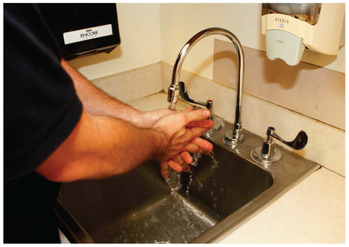
Proper Hand Hygiene (1 of 2)
Handwashing is the simplest, yet most effective way to control disease transmission.
Wash hands before and after patient contact, even if you wear gloves.
FIGURE 2-8 When washing your hands, rub your hands
together for at least 20 seconds to work up a lather. Pay
particular attention to your fingernails, the areas between
fingers, and the back of the hands.
© Jones & Bartlett Learning. Courtesy of MIEMSS.
Notes:
Lecture Outline
5. Proper hand hygiene
a. The simplest, yet most effective way to control disease transmission.
b. Wash hands before and after patient contact, even if you wear gloves.

Slide 32
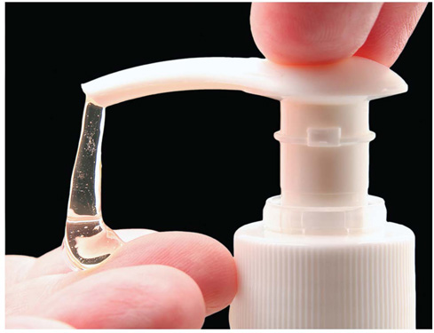
Proper Hand Hygiene (2 of 2)
If there is no running water, use a waterless handwashing substitute.
FIGURE 2-9 Use a waterless handwashing solution if
running water is not available. Be sure to wash your hands
with soap and water once you arrive at the hospital.
© Svanblar/ShutterStock.
Notes:
Lecture Outline
c. If there is no running water, use a waterless handwashing substitute.

Slide 33
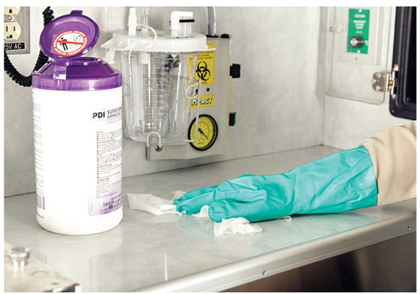
Gloves (1 of 2)
Wear gloves if there is any possibility for exposure to blood or body fluids.
Vinyl, nitrile, and latex gloves are effective protection.
FIGURE 2-10 Use heavy-duty utility gloves to clean the
unit. You should not use lightweight latex or vinyl gloves for cleaning.
© Jones & Bartlett Learning.
Notes:
Lecture Outline
6. Gloves
a. Wear gloves if there is any possibility for exposure to blood or body fluids.
b. Vinyl, nitrile, and latex gloves are effective protection. Wear heavy-duty gloves when cleaning the ambulance.
c. Change gloves between patients.

Slide 34
Gloves (2 of 2)
Removing gloves requires a special technique.
  Avoid contaminating yourself with materials on the outside of the gloves.
Notes:
Lecture Outline
d. Removing gloves requires a special technique to avoid contaminating yourself with the materials on the outside of the gloves (see Skill Drill 2-1).

Slide 35
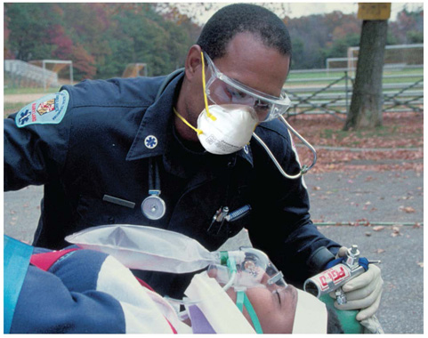
Eye Protection and Face Shields
Eye protection protects from blood splatters.
Prescription glasses are not adequate.
Goggles or face shields are best.
FIGURE 2-11 Wear eye protection with side shields to prevent blood splatter or airborne droplets from getting into your eyes.
© Jones & Bartlett Learning. Courtesy of MIEMSS.
Notes:
Lecture Outline
7. Eye protection and face shields
a. Eye protection protects from blood splatters.
b. Prescription glasses are not adequate.
c. Goggles or face shields are best.

Slide 36
Gowns
Provide protection from extensive blood splatter.
Worn in situations such as:
  Aerosol-generating procedures
  Field delivery of a baby
  Major trauma
Notes:
Lecture Outline
8. Gowns
a. Provide protection from extensive blood splatter.
b. May be worn in situations such as aerosol-generating procedures, field delivery of a baby or major trauma.

Slide 37
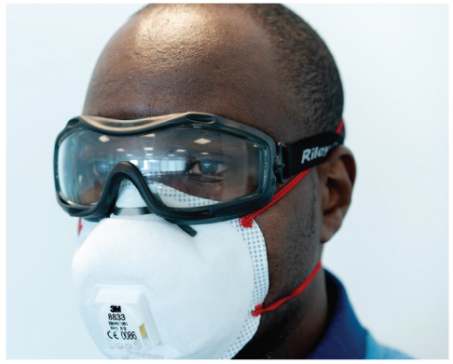
Masks, Respirators, and Barrier Devices (1 of 2)
Standard surgical mask for fluid spatter
Surgical mask on patient with communicable disease
  Mask with particulate air respirator on yourself if disease is tuberculosis
FIGURE 2-13 Wear a particulate respirator to protect yourself from airborne disease transmission.
© European Centre for Disease Prevention and Control (ECDC) 2020
Notes:
Lecture Outline
9. Masks, respirators, and barrier devices
a. Wear a standard surgical mask for fluid spatter.
b. Place a surgical mask on a patient and a particulate air respirator , such as an N95 on yourself, if you suspect the patient has an airborne- or droplet-spread disease such as tuberculosis, influenza, or COVID-19.
c. Protective eyewear using safety glasses with side shields, goggles, or a full-face shield is also needed.
d. If the patient needs oxygen place a nonrebreathing mask instead of a surgical mask on the patient and set the oxygen flow rate to 10 to 15 L/min.
e. Use of a particulate air respirator must comply with OSHA guidelines and be fit-tested to ensure their efficacy.

Slide 38
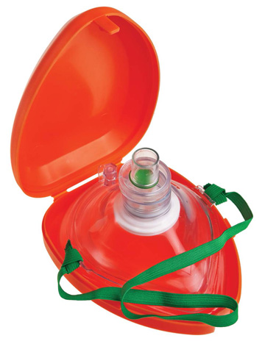
Masks, Respirators, and Barrier Devices (2 of 2)
Mouth-to-mouth resuscitation may transmit disease.
With an infected patient, use:
  Pocket mask
  Bag-mask device
Dispose of these devices according to local guidelines.
FIGURE 2-14 Barrier devices such as a pocket mask
provide protection when providing mouth-to-mask
ventilation. These devices should not be used, however, if
there is active community spread of virus by airborne route.
© Bart J/ShutterStock.
Notes:
Lecture Outline
f. Mouth-to-mouth or mouth to mask resuscitation is recommended in a situation where there is active community spread of an airborne virus.
g. Bag-mask ventilation is an aerosol-generating procedure that should be avoided in epidemic scenarios such as COVID -19.

Slide 39
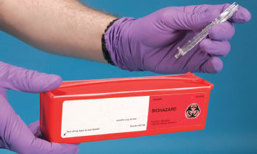
Proper Disposal of Sharps
Proper disposal helps avoid HIV and hepatitis
  Do not recap, break, or bend needles.
  Dispose of used sharp items in an
  approved closed
  container.
FIGURE 2-15 Properly dispose of sharps in a closed, rigid, marked container.
© Jones and Bartlett Learning. Courtesy of MIEMSS.
Notes:
Lecture Outline
10. Proper disposal of sharps
a. Proper disposal helps to avoid exposure to HIV and hepatitis.
b. Do not recap, break, or bend needles.
c. Dispose of used sharp items in an approved, closed, rigid container.

Slide 40
Employer Responsibilities
No guarantee of a 100% risk-free environment
  Risk of exposure to communicable disease is a hazard of your job.
  Follow OSHA and other national guidelines.
  Know your department’s infection control plan and follow it!
Notes:
Lecture Outline
11. Employer responsibilities
a. The risk of being exposed to a communicable disease is a hazard of your job.
b. Follow OSHA guidelines and other national guidelines and standards to reduce your risk of exposure to bloodborne pathogens and airborne diseases.
c. Know your department’s infection control plan and follow it.

Slide 41
Establishing an Infection Control Routine
Infection control should be part of your daily routine.
Clean the ambulance after each run and on a daily basis.
Cleaning should be done at the hospital whenever possible.
Notes:
Lecture Outline
G. Establishing an infection control routine (see Skill Drill 2-2)
H. Cleaning and decontaminating the ambulance and equipment
1. Clean the ambulance after each run and on a daily basis.
2. Whenever possible, cleaning should be done at the hospital. There is more information about cleaning the ambulance in Chapter 38, “Transport Operations.”
a. Any medical waste should be placed in a red biohazard bag and disposed of at the hospital.
b. Contaminated equipment left at the hospital should be cleaned by hospital staff or placed in a red bag for transport and cleaning at the station.
c. Use a bleach and water solution at a 1:10 dilution to clean the unit.
d. A hospital-approved disinfectant that is effective against Mycobacterium tuberculosis can also be used,
e. Remove contaminated linen and place it into an appropriate bag for handling.
f. Reusable medical equipment should be properly cleaned and sterilized per your department’s standard operating procedure.

Slide 42
Immunity
Even if germs reach you, you may not become infected.
  You may be immune.
Preventive measures
  Maintain your personal health.
  Receive immunizations.
Notes:
Lecture Outline
I. Immunity
1. Even if germs reach you, you are not necessarily at risk for infection.
a. Immunity is a major factor in determining which hosts become ill from which germs.
b. You may be immune, or resistant, to particular germs.
c. Immunity:
i. Having been immunized or vaccinated
ii. Able to recover from an infection from that germ

Slide 43
Immunizations
The CDC recommends immunizations for:
  Hepatitis B
  Influenza
  Measles, mumps, and rubella (MMR)
  Varicella vaccine or having had chickenpox
  Tetanus, diphtheria, pertussis (Tdap)
Skin test for tuberculosis
Notes:
Lecture Outline
2. Immunizations
a. A history of all your childhood infectious diseases should be recorded and kept on file.
i. Includes chickenpox, mumps, measles, rubella, and whooping cough.
b. The CDC recommends the following immunizations for health care workers:
i. Hepatitis B (required by OSHA)
ii. Influenza (yearly)
iii. Measles, mumps, and rubella (MMR)
iv. Varicella vaccine or having had the chickenpox
v. Tetanus, diphtheria, pertussis (Tdap) (every 10 years)
c. Skin test for tuberculosis prior to hire and annually

Slide 44
General Postexposure Management
If you are exposed to a patient’s blood or bodily fluids:
  Turn over patient care to another EMS provider.
  Clean the exposed area.
  Rinse your eyes if necessary (20 minutes).
  Activate your department’s infection control plan.
  Complete an exposure report.
Notes:
Lecture Outline
J. General postexposure management
1. If you are exposed to a patient’s blood or bodily fluids:
a. Turn over patient care to another EMS provider.
b. Clean the exposed area with soap and water.
c. If your eyes were exposed, rinse your eyes for 20 minutes.
d. Activate your department’s infection control plan.
2. You will have to complete an exposure report and be screened to determine whether there was a significant exposure to bloodborne pathogens.
3. If you were exposed to a highly communicable airborne disease such as COVID-19 without proper PPE, you may be required to quarantine for a predetermined period of time.
4. Postexposure prophylaxis and treatment for significant exposure

Slide 45
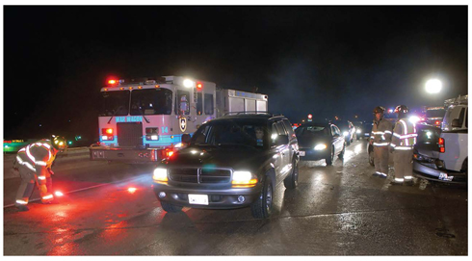
Scene Safety
Begin protecting yourself as soon as you are dispatched.
Continue to protect yourself once on scene.
FIGURE 2-18 Make sure the crash scene is well marked to prevent a second crash that may damage the ambulance or result in injury to you, your partner, or the patient.
© Glen E. Ellman.
Notes:
Lecture Outline
IV. Scene Safety
A. The personal safety of all those involved in an emergency situation is very important.
1. Begin protecting yourself as soon as you are dispatched.
a. Wear seat belts.
b. Don appropriate PPE.
2. Continue to protect yourself once on scene.
a. Make sure the scene is well marked.
b. Place warning devices to alert other motorists of the scene.
c. Park at a safe distance from the scene.
d. Make sure there is plenty of light if it is dark.
e. Wear reflective clothing if it is dark.

Slide 46
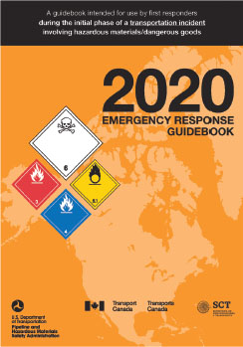
Scene Hazards (1 of 4)
Hazardous materials
  Identify what you can from a distance.
  Do not enter unless safe to do so.
FIGURE 2-21 The US Department of Transportation’s Emergency Response Guidebook lists many hazardous materials and the proper procedures for scene control and emergency care of patients.
Courtesy of US Department of Transportation.
Notes:
Lecture Outline
B. Scene hazards
1. Hazardous materials
a. Upon arrival, look at the scene and try to read any labels, placards, and identification numbers from a distance, perhaps using binoculars.
b. A specially trained and equipped hazardous materials team will be called to the scene to handle disposal of materials and removal of patients.
c. Do not begin caring for patients until they have been moved away from the scene and are decontaminated or the scene is safe for you to enter.
d. Do not enter the scene unless it is safe to do so.
e. The US Department of Transportation’s Emergency Response Guidebook (ERG) lists common hazardous material and the proper procedure for for scent control and emergency care of patients.
f. Smartphone and tablet apps are also available.
g. General guidelines:
i. Do not enter the scene if there is evidence of hazardous materials.
ii. Remain upwind and uphill of the scene.
iii. Keep your distance
iv. Quickly contact dispatch and request additional resources.
v. Do not enter the scene until instructed by trained hazardous materials responders.

Slide 47
Scene Hazards (2 of 4)
Electricity
  Beyond the scope of EMT training
  Mark off a danger zone.
  Lightning
    A repeat strike can occur.
    Either direct hit or ground current is possible.
Notes:
Lecture Outline
2. Electricity
a. Dealing with downed power lines is beyond the scope of EMT training.
b. Mark off a danger zone around the downed lines using utility poles as landmarks. The safety zone is one span of the power pole’s distance.
c. Do not approach a downed wire or touch anything which downed wires are in contact until qualified personnel have determined no risk is present.
d. Lightning is a threat in two ways:
i. A direct hit
ii. Ground current
e. A repeat lightning strike in the same area can occur.
f. Avoid high ground to minimize risk of a direct lightning strike.
g. To avoid being injured by ground current, stay away from drainage ditches, moist areas, small depressions, and wet ropes.
h. When lightning is nearby, make yourself the smallest target possible and drop all equipment.

Slide 48
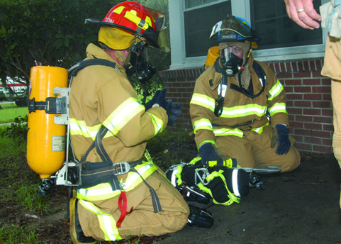
Scene Hazards (3 of 4)
Fire
  Fire hazards include smoke, oxygen deficiency, high temperatures, toxic gases, and building collapse.
  Use proper protection.
FIGURE 2-23 EMTs who are also firefighters should be
trained in the use of self-contained breathing apparatus
and have it available if working near fire scenes.
© Courtesy of Lance Cpl. Brian Kester/U.S. Marines.
Notes:
Lecture Outline
3. Fire
a. Common hazards:
i. Smoke
ii. Oxygen deficiency
iii. High ambient temperatures
iv. Toxic gases
v. Building collapse
vi. Equipment
vii. Explosions

Slide 49
Scene Hazards (4 of 4)
Vehicle crashes
  Common events for EMS providers
  Traffic
  Unstable vehicles
  Downed power lines
  Sharp objects
    Use protective gear
Notes:
Lecture Outline
4. Vehicle crashes
a. Vehicle crashes are common events for EMS providers.
b. Vehicle collision hazards include traffic, an unstable vehicle downed power lines, risk of violence, airbags, leaking fluids sharp objects.
c. Use sufficient protective gear to reduce the risk of injury.

Slide 50
Scenes of Violence (1 of 4)
Assaults
Hostage situations
Riots
Notes:
Lecture Outline
C. Scenes of violence
1. Assaults, hostage situations, riots, or other disturbance
a. Scene assessment should begin while en route
b. Once on scene continue your assessment using personal observation and information from other responders while maintaining personal safety and the safety of your team.

Slide 51
Scenes of Violence (2 of 4)
Mass violence
  Know who is in command.
  Remain vigilant for the potential for violence.
  Allow law enforcement to clear the scene.
  At scenes involving projectiles find protection.
    Cover
    Concealment
Notes:
Lecture Outline
2. Mass Violence
a. Several agencies will be involved. Know who is in command.
b. Remain vigilant for the potential for violence at all times.
c. Allow law enforcement to secure the scene before you approach
d. At scenes involving projectiles find protection.
i. Cover: the tactical use of an impenetrable barrier for protection.
ii. Concealment: hiding behind objects to limit a person’s ability to see you.
e. If you believe the event is a crime scene, attempt to maintain the chain of evidence and do not disturb the scene unless it is absolutely necessary for patient treatment.

Slide 52
Scenes of Violence (3 of 4)
Recommendations for preventing violence
  Training and practice identifying scenes of potential violence
  Training and practice with deescalation strategies and techniques
  Training and practice improving interpersonal communication
  Dispatch identification and alerting of past or potential threats of violence
Notes:
Lecture Outline
3. Violence against responders
a. The rate of violence-related injuries with work loss for emergency responders is 22 times higher than the overall rate for other employees in the United States.
b. Recommendations for the prevention of violence:
i. Training and practice in identifying scenes of potential violence
ii. Training and practice in de-escalation strategies and techniques
iii. Training and practice to improve interpersonal communication
iv. Practice in ongoing scene assessment
v. Dispatch identification and alerting of past or potential threats of violence

Slide 53
Scenes of Violence (4 of 4)
Recommendations for protection against violence:
  Training and practice in self-defense and escape techniques
  Training and practice with physical and chemical escape techniques
  Fitting and use of body armor
  Training and practice in operations with law enforcement
Notes:
Lecture Outline
c. Recommendations for protection against violence:
i. Training and practice in self-defense and escape techniques
ii. Training and practice in physical and chemical restraint techniques
iii. Fitting and use of body armor
iv. Training and practice in operations with law enforcement

Slide 54
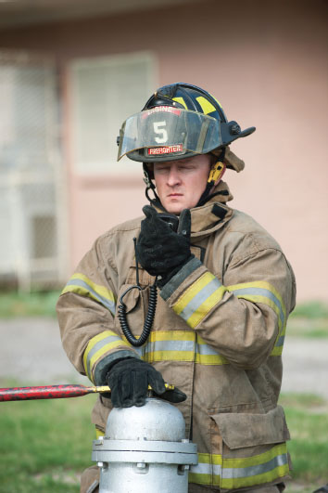
Protective Clothing: Preventing Injury (1 of 3)
Critical to personal safety
Become familiar with various types
Cold-weather clothing
  Three layers
Turnout gear
  Heat, fire, sparks, and flashover
FIGURE 2-25 Turnout gear, or bunker gear, is protective clothing designed for use in firefighting
© Jones & Bartlett Learning. Photographed by Glen E. Ellman.
Notes:
Lecture Outline
V. Protective Clothing: Preventing Injury
A. Wearing protective clothing and other appropriate gear is critical to your personal safety.
B. Become familiar with the protective equipment available to you.
C. Inspect your clothing and gear regularly—ideally before you reach the scene.
D. Types
1. Cold-weather clothing consists of three layers:
a. A thin inner layer that pulls moisture away from the skin
b. A thermal middle layer that serves as insulation
c. An outer layer that resists wind, rain, sleet, and snow
2. Turnout gear
a. Protects from heat, fire, sparks, and flashover
b. Also called bunker gear

Slide 55

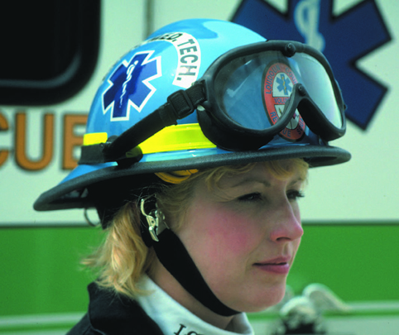
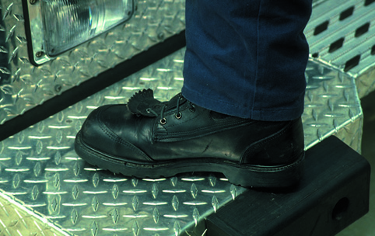
Protective Clothing: Preventing Injury (2 of 3)
Gloves
  Heat, cold, cuts
  May reduce dexterity
Helmets
  Falling objects
Boots
  Steel-toed is preferred
FIGURE 2-26 Firefighting gloves protect your hands and wrists from heat, cold, and injury.
FIGURE 2-27 A helmet with top and side impact protection.
© Jones & Bartlett Learning. Courtesy of MIEMSS.
© Jones & Bartlett Learning. Photographed by Glen E. Ellman.
FIGURE 2-28 Boots should cover and protect your ankles, keeping out stones, debris, and snow. Steel-toed boots are preferred.
© Jones & Bartlett Learning. Courtesy of MIEMSS.
Notes:
Lecture Outline
3. Gloves
a. Protect from heat, cold, and cuts
b. May reduce dexterity in a rescue situation
4. Helmets
a. Helmets should be worn anytime you are working in a fall zone.
b. Helmets should provide top and side impact protection, as well as a secure chin strap.
c. Construction-type helmets are not well suited for rescue situations.
d. A helmet with a chin strap and face shield should always be worn in situations involving electrical hazards.
5. Boots
a. Should be water resistant, fit well, and be flexible
b. Steel-toed boots are preferred.
c. Traction is important for rescue situations.

Slide 56
Protective Clothing: Preventing Injury (3 of 3)
Eye protection
  Glasses with side shield
Ear protection
  Foam earplugs
Skin protection
  Sunblock
Body armor
  Vests
Notes:
Lecture Outline
6. Eye protection
a. Wear protective glasses with side shields during routine patient care.
b. When tools are in use, use a face shield and goggles.
7. Ear protection
a. Soft foam industrial-type earplugs
8. Skin protection
a. Protect against sunburn during outside work.
b. Use a sunscreen with a minimum rating of SPF 15.
9. Body armor
a. Bulletproof vests
b. Range from lightweight and flexible to heavy and bulky
c. Vests may not be practical for daily use; they are costly and do not protect against rifle ammunition or stabling attacks.
10. Long/loose hair, rings, and jewelry
a. Many EMS services have restricted policies regarding hair, rings, and jewelry.
b. You should tie hair up neatly, limit the number of rings worn, and wear only a watch on the wrist.

Slide 57
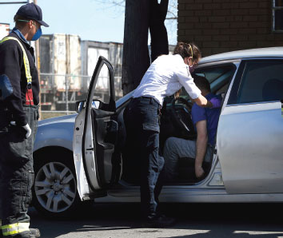
Caring for Critically Ill and Injured Patients (1 of 3)
Let the patient know who you are and what you are doing.
Let the patient know you are attending to his or her immediate needs.
FIGURE 2-29 Let the patient know immediately that you are there to help.
© Boston Globe/Boston Globe/Getty Images
Notes:
Lecture Outline
VI. Caring for Critically Ill and Injured Patients
A. The patient needs to know who you are and what you are doing.
1. Let the patient know that you are attending to his or her immediate needs.
2. Avoid making unprofessional comments during resuscitation.
3. Treat all patients with dignity and respect.

Slide 58
Caring for Critically Ill and Injured Patients (2 of 3)
Communicating with the critical patient:
  Avoid sad and grim comments.
  Orient the patient.
  Be honest.
  Deal with possible initial refusal of care.
  Allow for hope.
  Locate and notify family members.
Notes:
Lecture Outline
B. Techniques for communicating with the critical patient
1. Avoid sad and grim comments.
a. Remarks about a patient’s condition may increase the patient’s anxiety or compromise recovery.
2. Orient the patient.
a. Use brief statements.
b. Orient the patient to his or her surroundings.
3. Be honest.
a. Decide how much information your patient can understand and accept.
b. Allow the patient to be part of the care being given.
4. Allow for hope.
a. If there is the slightest chance of hope remaining, transmit that message to the patient.
C. Locate and notify family members.
1. Assure the patient that you will take care of notifying the appropriate people.

Slide 59
Caring for Critically Ill and Injured Patients (3 of 3)
Injured and critically ill children
  Ask a responsible adult to accompany the child.
Death of a child
  A tragic event
  Help the family in any way you can.
  Let the family’s actions be your guide.
  Prepare the parents.
Notes:
Lecture Outline
D. Injured and critically ill children
1. Children should be cared for as any adult would be.
2. It is important that a relative or responsible adult accompany the child to relieve anxiety and assist in care as appropriate.
E. Coping with the death of a child
1. The death of a child is a tragic and dreaded event.
2. Help the family through the initial period after the death.
F. Helping the family
1. Acknowledge the death in a private place.
2. Shock, denial, and disbelief are common emotions and reactions to a child’s death.
3. If circumstances allow, let the parents hold the child. Use your best judgment to determine if this is appropriate.
4. Let the family’s actions be your guide.
5. The family may want to see the child, and you should allow them to do so.
6. Prepare the parents for what they will see.
7. Do not overload the grieving parents with information.

Slide 60
Death and Dying (1 of 4)
Death occurs:
  Quite suddenly
  After a prolonged, terminal illness
The EMT will face death.
Notes:
Lecture Outline
VII. Death and Dying
A. Death is likely to be either:
1. Quite sudden
2. After a prolonged, terminal illness
B. The EMT will sometimes face death.

Slide 61
Death and Dying (2 of 4)
Stages of grieving:
  Denial
  Anger, hostility
  Bargaining
  Depression
  Acceptance
Notes:
Lecture Outline
C. The grieving process:
1. Denial
2. Anger, hostility
3. Bargaining
4. Depression
5. Acceptance

Slide 62
Death and Dying (3 of 4)
The EMT’s role:
Ask how you can help.
Reinforce reality.
Be honest.
Allow the patient and family to grieve.
Notes:
Lecture Outline
D. What can the EMT do?
1. Ask the patient and family if there is anything you can do to help.
2. Reinforce the reality of the situation.
3. Be honest and sincere.
4. Do not say you know how the patient or family feels.
5. Let the patient or family members grieve in their own way.

Slide 63
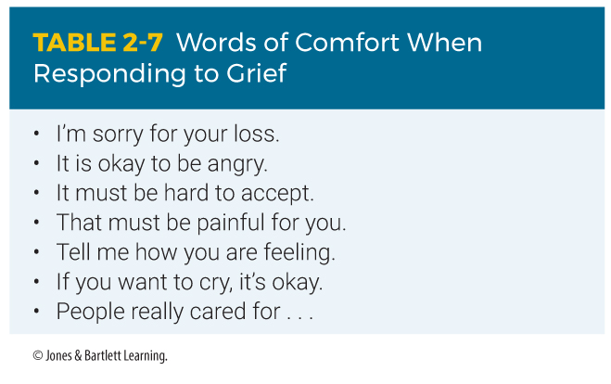
Death and Dying (4 of 4)
Notes:
The table on this slide shows suggestions for responding to grief.

Slide 64
Stress Management on the Job (1 of 2)
EMS is a high-stress job.
Important to know causes and how to deal with stress
General adaptation syndrome
  Alarm response to stress
  Reaction and resistance
  Recovery—or exhaustion
Notes:
Lecture Outline
VIII. Stress Management on the Job
A. EMS is a high-stress job.
B. It is important to know the causes of stress and ways to deal with stress.
1. Stressors include emotional, physical, and environmental situations.
C. General adaptation syndrome
1. Alarm response to stress
2. Reaction and resistance to stress
3. Recovery—or exhaustion from stress

Slide 65
Stress Management on the Job (2 of 2)
Physiologic signs of stress
  Increased respirations and heart rate
  Increased blood pressure
  Cool, clammy skin
  Dilated pupils
  Tensed muscles
  Increased blood glucose level
  Perspiration
  Decreased blood flow to gastrointestinal tract
Notes:
Lecture Outline
D. Physiologic manifestations of stress:
1. Increased respirations and heart rate
2. Increased blood pressure
3. Dilated venous vessels near the skin surface (cause cool, clammy skin)
4. Dilated pupils
5. Tensed muscles
6. Increased blood glucose levels
7. Perspiration
8. Decreased blood flow to the gastrointestinal tract

Slide 66
Stressful Situations (1 of 2)
Dangerous situations
Physical and psychological demands
Critically ill or injured patients
Dead and dying patients
Overpowering sights, smells, and sounds
Notes:
Lecture Outline
E. Situations that are stressful for EMS providers include the following:
1. Dangerous situations
2. Physical and psychological demands
3. Critically ill or injured patients
4. Dead and dying patients
5. Overpowering sights, smells, and sounds

Slide 67
Stressful Situations (2 of 2)
Multiple patient situations
Angry or upset patients, family, or bystanders
Unpredictability and demands of EMS
Notes:
Lecture Outline
6. Multiple-patient situations
7. Angry or upset patients, family, or bystanders
8. Unpredictability and demands of EMS

Slide 68
Stress Reactions (1 of 4)
Acute stress reactions
  Occur during a stressful situation
Delayed stress reactions
  Manifest after stressful event
Cumulative stress reactions
  Prolonged or excessive stress
Notes:
Lecture Outline
F. Stress reactions
1. Acute stress reactions
a. Occur during a stressful situation
2. Delayed stress reactions
a. Manifest after stressful event
3. Cumulative stress reactions
a. Prolonged or excessive stress

Slide 69
Stress Reactions (2 of 4)
Physical symptoms of stress
  Fatigue
  Changes in appetite
  GI problems
  Headaches
  Insomnia or hypersomnia
  Irritability
  Inability to concentrate
  Hyperactivity or underactivity
Notes:
Lecture Outline
b. Physical symptoms
i. Fatigue
ii. Changes in appetite
iii. Gastrointestinal problems
iv. Headaches
v. Insomnia or hypersomnia
vi. Irritability
vii. Inability to concentrate
viii. Hyperactivity or underactivity

Slide 70
Stress Reactions (3 of 4)
Psychological symptoms
  Fear
  Dull or nonresponsive behavior
  Depression
  Guilt
  Oversensitivity, anger, irritability, and frustration
Notes:
Lecture Outline
c. Psychological symptoms
i. Fear
ii. Dull or nonresponsive behavior
iii. Depression
iv. Guilt
v. Oversensitivity, anger, irritability and frustration

Slide 71
Stress Reactions (4 of 4)
Critical incident stress is caused by acute severe stressors.
  Mass-casualty incidents
  Serious injury or traumatic death of a child
  Crashes with injuries caused by an emergency provider while traveling to or from a call
  Death or serious injury of a coworker in the line of duty
Notes:
Lecture Outline
4. Critical incident stress is brought about by acute severe stressors
a. Mass-casualty incidents
b. Serious injury or traumatic death of a child
c. Crashes with injuries caused by an emergency provider while traveling to or from a call.
d. Death or serious injury of a coworker in the line of duty.

Slide 72
Posttraumatic Stress Disorder (1 of 2)
May develop following a psychologically distressing event
Characterized by reexperiencing the event and overresponding to stimuli that recall the event
Notes:
Lecture Outline
1. May develop after a person has experienced a psychologically distressing event.
2. Characterized by reexperiencing the event and overresponding to stimuli that recall the event.

Slide 73
Posttraumatic Stress Disorder (2 of 2)
Critical incident stress management
  Used to help providers relieve stress
  Can occur formally or at an ongoing scene
  Facilitated by trained professionals
Notes:
Lecture Outline
3. CISM is used to help providers relieve stress.
CISM can occur formally or at an ongoing scene.
Trained CISM professionals facilitate.
i. Defusing sessions are held during or immediately after the event.
ii. Debriefing sessions are held 24–72 hours after the incident.
iii. An important rule is to not turn the debriefing session into an operational critique.
c. If CISM is not an option, private counseling by a mental health professional may be preferable.

Slide 74
Burnout
A combination of exhaustion, cynicism, and reduced performance resulting from long-term job stress
Affects the well-being of the EMT along with that of crew members and patients
Notes:
Lecture Outline
H. Burnout
1. Describes a combination of exhaustion, cynicism, and reduced performance resulting from long-term job stress.
2. Affects the well-being of the EMT along with that of his or her colleagues and patients.
3. Can result in increased major medical errors, increased rates of health care-associated infection, and increased patient mortality.
4. Also contributes to decreases in work morale, overall work effort, effective teamwork, patient satisfaction, and an increase in job turnover.

Slide 75
Compassion Fatigue
Also known as secondary stress disorder
Characterized by gradual lessening of compassion
Symptoms:
  High absenteeism
  Inability to work in teams
  Lack of empathy for patients
  Judgmental attitude towards patients
Notes:
Lecture Outline
I. Compassion fatigue
1. Common among health care providers
2. Also known as secondary stress disorder
3. Characterized by gradual lessening of compassion over time
4. Symptoms:
a. High absenteeism
b. Difficult relationship with colleagues and coworkers
c. Inability to work in teams
d. Aggressive behavior towards patients
e. Strong negative attitudes toward work
f. Lack of empathy for patients
g. Judgmental attitude toward patients
h. Preoccupation with nonwork issues while on duty
i. Other symptoms of increased stress

Slide 76
Responder Risk for Suicide
Suicide rate among emergency responders is higher than the rest of the population.
Job stress is considered to be the largest contributing factor to suicide.
Several organizations and mental health services are available to provide emotional support.
Notes:
Lecture Outline
J. Responder risk for suicide
1. The suicide rate among emergency responders is higher than the rest of the population.
2. Job stress is widely considered to be the largest contributing factor to suicide.
3. Several organizations and mental health services are available to provide emotional support.

Slide 77
Emotional Aspects of Emergency Care
At times health care providers have trouble overcoming personal reactions and proceeding without hesitation.
The struggle to remain calm in the face of horrible circumstances contributes to emotional stress.
Notes:
Lecture Outline
K. Emotional aspects of emergency care
1. At times, even the most experienced health care provider has difficulty overcoming personal reactions and proceeding without hesitation.
2. The struggle to remain calm in the face of horrible circumstances contributes to the emotional stress of the job.

Slide 78
Stressful Situations
Many factors influence how a patient reacts to the stress of an EMS incident.
Quickly and calmly assess the actions of the patient, family members, and bystanders.
Use a professional tone and show courtesy.
Allow the patient to express their fear.
Respect religious customs and needs.
Notes:
Lecture Outline
L. Stressful situations
1. During stressful situations you must exercise extreme professional care in both your words and your actions at the scene.
2. Factors that influence how a patient reacts to the stress of an EMS incident.
a. Socioeconomic background
b. Fear of medical personnel
c. Alcohol or substance use disorders
d. History of chronic illness
e. Mental disorders
f. Reaction to medication
g. Age
h. Nutritional status
i. Feelings of guilt
j. Past experience with illness or injury
3. Quickly and calmly assess the actions of the patient, family members, and bystanders.
4. Use a professional tone and show courtesy, along with sincere concern and efficient action.
5. Patients must be given the opportunity to express their fears and concerns.
6. Religious customs or needs of the patient must be respected.
a. Some people have religious convictions that strongly oppose the use of medications, blood, and blood products. Report this information to the next level of care.
7. In the event of a death, handle the body with respect and dignity.

Slide 79
Workplace Issues (1 of 4)
Cultural diversity on the job
  You are expected to work with coworkers of varying backgrounds, beliefs, and values.
  Culture includes nationality, age, disability, sex, sexual orientation, marital status, work experience, and education.
  Communicate in a way that is sensitive to everyone’s needs.
  Remain curious and openminded.
Notes:
Lecture Outline
IX. Workplace Issues
A. Cultural diversity on the job
1. You are expected to work alongside coworkers with varying backgrounds, attitudes, beliefs, and values and to accept their differences.
2. Culture is not restricted to different nationalities, you should also consider age, disability, sex, sexual orientation, marital status, work experience, and education.
3. Communicate in a way that is sensitive to everyone’s needs.
4. Your ultimate goal should be cultural humility.
a. Remain curious about others and continuously reflect on your viewpoints with an open mind.

Slide 80
Workplace Issues (2 of 4)
Sexual harassment
  Two types
    Quid pro quo: request for sexual favors
    Hostile work environment: jokes, touching, etc.
  Report harassment to your supervisor immediately and keep notes.
Notes:
Lecture Outline
2. Two types of sexual harassment:
a. Quid pro quo
i. The harasser requests sexual favors in exchange for something else, such as a promotion.
b. Hostile work environment
i. Jokes, touching, leering, requests for a date, talking about body parts
3. The intent of the harasser does not matter, but rather the perception of the act and the impact the behavior has on someone else.
4. Because EMTs and other public safety professionals depend on one another for their safety, it is especially important for you to develop nonadversarial relationships with coworkers.
5. Report harassment to your supervisor immediately.

Slide 81
Workplace Issues (3 of 4)
Substance abuse
  Increases risks on the job
  Leads to poor decision making
  Seek help or find a way to confront an addicted coworker.
  Employee assistance programs (EAPs) are often available.
Notes:
Lecture Outline
C. Substance abuse
1. Increases risks of accidents and tension
2. Causes poor treatment decisions
3. Many EMS systems now require personnel to undergo periodic random tests for illegal drugs and have “for cause” testing when it is believed that individuals are under the influence of alcohol or drugs.
4. Addicts and alcoholics develop great skills at covering for their behavior.
5. Seek help or find a way to confront an addicted coworker.
6. Allowing substance abuse to go on presents a tremendous hazard to the public.
7. Employee assistance programs (EAPs) are often available.

Slide 82
Workplace Issues (4 of 4)
Injury and illness prevention
Program should contain:
  Management leadership
  Worker participation
  Hazard identification and assessment
  Hazard prevention and control
  Education and training
  Program evaluation and improvement
Notes:
Lecture Outline
D. Injury and illness prevention
1. EMS providers visit EDs for work-related injuries and exposures over 20,000 times each year.
2. Each program should include six interrelated and interdependent elements:
a. Management leadership
b. Worker participation
c. Hazard identification and assessment
d. Hazard prevention and control
e. Education and training
f. Program evaluation and improvement

Slide 83
Review
A disease that can be spread from person-to-person is known as:
  an infectious disease.
  a communicable disease.
  a transmittable disease.
  a spreadable disease.

Slide 84
Review
Answer: B
Rationale: A communicable disease can be spread from one person or a species to another.

Slide 85
Review
A disease that can be spread from person-to-person is known as:
  an infectious disease.
    Rationale: An infectious disease is a medical condition caused by the growth and spread of small, harmful organisms within the body.
  a communicable disease.
    Rationale: Correct answer
  C. a transmittable disease.
    Rationale: The correct answer is an infectious disease.
  D. a spreadable disease.
    Rationale: The correct answer is an infectious disease.

Slide 86
Review
The MOST effective way of preventing the spread of disease is:
  handwashing.
  keeping your immunizations up-to-date.
  placing a HEPA respirator on the patient.
  wearing goggles, gloves, a gown, and a mask.

Slide 87
Review
Answer: A
Rationale: According to the CDC, the most effective way of preventing the spread of disease is thorough handwashing—especially in between patients. Up-to-date immunizations and PPE will minimize the risk of contracting a disease.

Slide 88
Review
The MOST effective way of preventing the spread of disease is:
  handwashing.
  Rationale: Correct answer
  keeping your immunizations up-to-date.
  Rationale: This is part of the overall prevention process.
  placing a HEPA respirator on the patient.
  Rationale: This PPE helps to block the entry of an organism into the rescuer.
  wearing goggles, gloves, a gown, and a mask.
  Rationale: This PPE is selected according to manner in which a communicable disease is spread.

Slide 89
Review
While caring for a trauma patient, the EMT has blood splashed into her eyes. This is an example of:
  infection.
  exposure.
  indirect contact.
  transmission.

Slide 90
Review
Answer: B
Rationale: Exposure occurs when a person comes in (direct or indirect) contact with blood or other bodily fluids. Blood splattered into the eyes is an example of direct contact. It is important to note that exposure does not always lead to infection. Proper use of PPE minimizes this risk.

Slide 91
Review
While caring for a trauma patient, the EMT has blood splashed into her eyes. This is an example of:
  infection.
  Rationale: This is an abnormal invasion by an organism.
  exposure.
  Rationale: Correct answer
  indirect contact.
  Rationale: This is exposure through contact with a contaminated object.
  transmission.
  Rationale: This is the way an infectious agent is spread including direct, indirect, and airborne transmission.

Slide 92
Review
Protective measures that prevent health care workers from coming into contact with germs are referred to as:
  exposure.
  standard precautions.
  transmission.
  PPE.

Slide 93
Review
Answer: B
Rationale: Standard precautions prevent health care workers from coming into contact with germs.

Slide 94
Review
Protective measures that prevent health care workers from coming into contact with germs are referred to as:
  exposure.
  Rationale: Exposure occurs when a person comes into contact with blood or body fluids.
  standard precautions.
  Rationale: Correct answer
  transmission.
  Rationale: Transmission is the way in which an infectious agent is spread.
  PPE.
  Rationale: PPE is the equipment used to shield health care workers from infectious agents.

Slide 95
Review
What is the second stage of response in the stress response known as the general adaptation syndrome?
  Recovery
  Exhaustion
  Alarm
  Reaction and resistance

Slide 96
Review
Answer: D
Rationale: The body typically reacts to stress in three stages: the alarm response, which is followed by reaction and resistance, and then recovery. If the individual cannot reduce stress, the last stage may progress to exhaustion.

Slide 97
Review
What is the second stage of response in the stress response known as the general adaptation syndrome?
  Recovery
  Rationale: This is the third stage.
  Exhaustion
  Rationale: If the third stage (recovery) is prolonged, then exhaustion occurs.
  Alarm
  Rationale: This is the first stage.
  Reaction and resistance
  Rationale: Correct answer

Slide 98
Review
A condition characterized by reexperiencing an event and overresponding to stimuli that recall the event is called:
  acute stress reaction.
  delayed stress reaction.
  cumulative stress reaction.
  posttraumatic stress disorder (PTSD).

Slide 99
Review
Answer: D
Rationale: PTSD may develop after a person has experienced a psychologically distressing event.

Slide 100
Review
A condition characterized by reexperiencing an event and overresponding to stimuli that recall the event is called:
  acute stress reaction.
  Rationale: This occurs during a stressful event.
  delayed stress reaction.
  Rationale: This occurs after a stressful event.
  cumulative stress reaction.
  Rationale: This occurs when the EMT is exposed to prolonged or excessive stress.
  posttraumatic stress disorder.
  Rationale: Correct answer

Slide 101
Review
______ is the fuel to make the body run.
  Sleep
  Exercise
  Food
  Work/life balance

Slide 102
Review
Answer: C
Rationale: To perform efficiently, you must eat nutritious food. The physical exertion and stress of your job require high energy output.

Slide 103
Review
______ is the fuel to make the body run.
  Sleep
  Rationale: A consistent cycle of sleep will improve concentration and motivation.
  Exercise
  Rationale: A regular program of exercise will increase strength and endurance.
  Food
  Rationale: Correct answer
  Work/life balance
  Rationale: A balance will allow you to relax off the job and motivate you on the job.

Slide 104
Review
Which stage of grieving commonly results in blame?
  Denial
  Anger, hostility
  Bargaining
  Depression

Slide 105
Review
Answer: B
Rationale: The person may lash out at the EMT or blame the EMT for the unfortunate event.

Slide 106
Review
Which stage of grieving commonly results in blame?
  Denial
  Rationale: Denial is refusal to accept the circumstances.
  Anger, hostility
  Rationale: Correct answer
  C. Bargaining
  Rationale: The patient may try to make a deal.
  Depression
  Rationale: Depression commonly results in a silent patient.

Slide 107
Review
Placards are used on:
  buildings.
  individual packages.
  storage lockers.
  storage papers.

Slide 108
Review
Answer: A
Rationale: Placards are used for buildings and transportation vehicles.

Slide 109
Review
Placards are used on:
  buildings.
  Rationale: Correct answer
  individual packages.
  Rationale: Labels are used to identify packages.
  storage lockers.
  Rationale: Placards are used for buildings and transportation vehicles.
  D. storage papers.
  Rationale: Placards are used for buildings and transportation vehicles.

Slide 110
Review
The five most common hazards associated with a structural fire include:
  smoke, oxygen deficiency, high ambient temperatures, toxic gases, and building collapse.
  smoke, oxygen deficiency, inhalation of tar particles, injury from breaking glass, and building collapse.
  smoke, high ambient temperatures, toxic gases, electric shock, and inhalation of tar particles.
  oxygen deficiency, high ambient temperatures, toxic gases, electric shock, and injury from breaking glass.

Slide 111
Review
Answer: A
Rationale: The five hazards most commonly associated with a structural fire are smoke, oxygen deficiency, high ambient temperatures, toxic gases, and building collapse.

Slide 112
Review (1 of 2)
The five most common hazards associated with a structural fire include:
  smoke, oxygen deficiency, high ambient temperatures, toxic gases, and building collapse.
  Rationale: Correct answer
  smoke, oxygen deficiency, inhalation of tar particles, injury from breaking glass, and building collapse.
  Rationale: Smoke is made up of particles of both tar and carbon.

Slide 113
Review (2 of 2)
The five most common hazards associated with a structural fire include:
  smoke, high ambient temperatures, toxic gases, electric shock, and inhalation of tar particles.
  Rationale: Smoke is made up of particles of both tar and carbon.
  oxygen deficiency, high ambient temperatures, toxic gases, electric shock, and injury from breaking glass.
  Rationale: Smoke is missing from this option.

